Slide 1
Demystifying Digital
Financial Services
Digital Islamic Innovation
The Digital Revolution and Islamic Financial Inclusion
10th Global Islamic Microfinance Forum

Slide 2
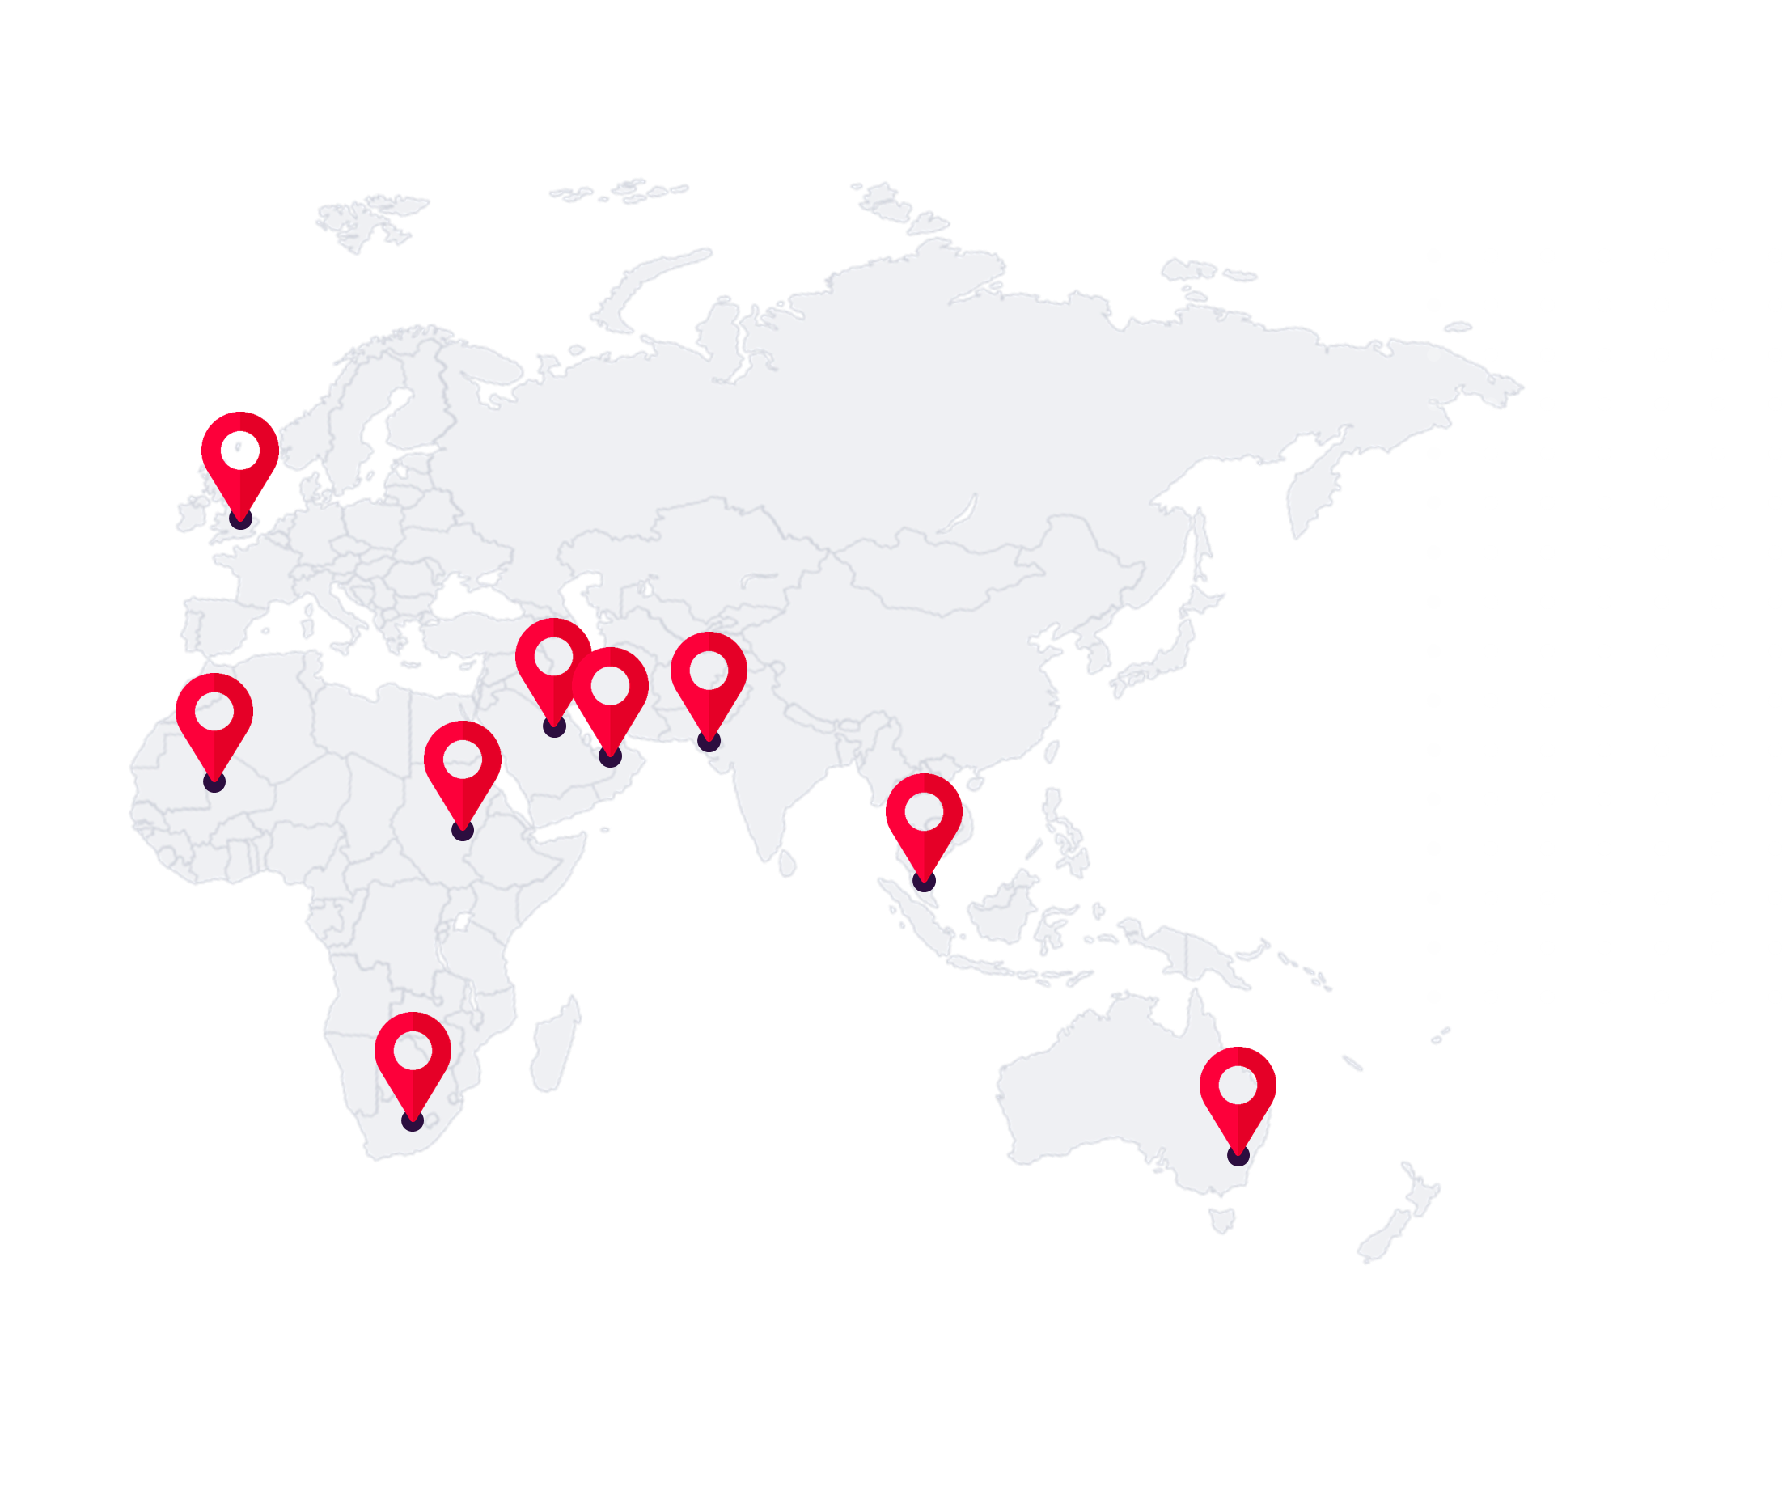
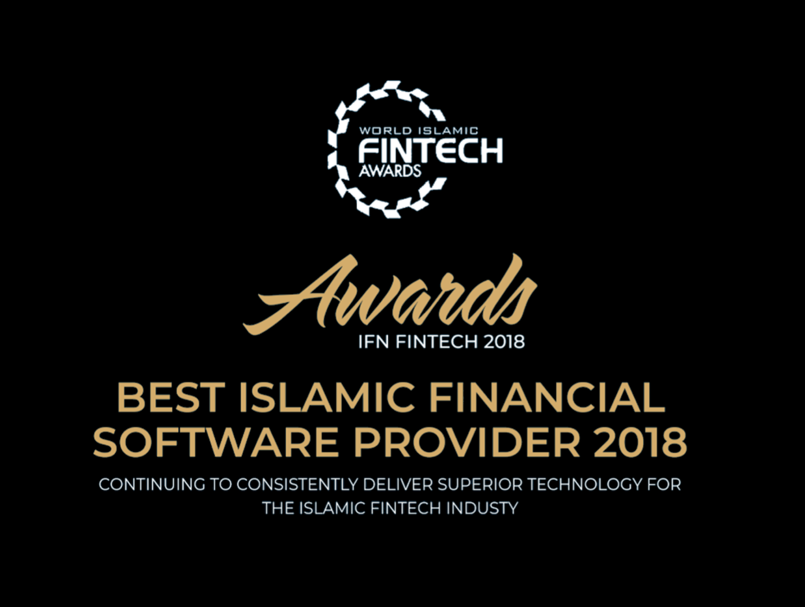
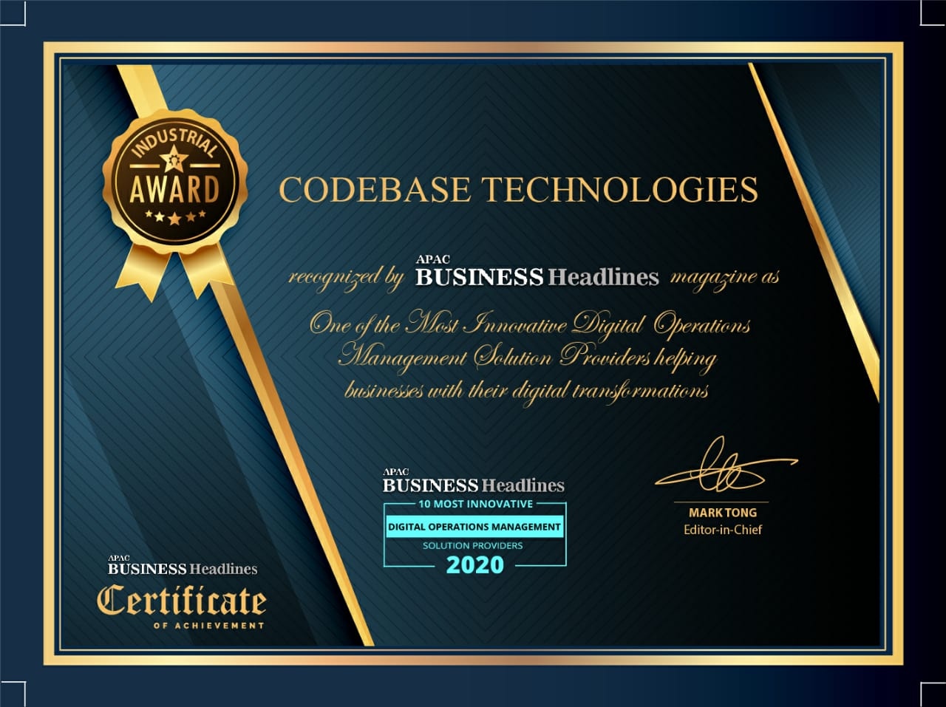
About Codebase Technologies
Codebase Technologies (CBT) is a Global Open API Banking solutions provider that enables banks and financial institutions (both Conventional and Islamic) as well as the emerging FinTech ecosystem to Demystify Digital Financial Services. We help organizations create and deliver Innovative and Intuitive experiences across customer lifecycle.
With presence and customers across 4 continents, Codebase Technologies with its award-winning suite of products, including the innovative Digibanc™, a comprehensive one-stop ‘Bank in box’, helps its customers unlock the true potential of the next generation of the digital financial eco-system.
Awards and Recognitions:

Slide 3
01
Digital Islamic Banking

Slide 4
The global Islamic financial landscape is currently valued at $2.2 trillion and expected to continue growing 10% to 12% in the next year.
Source: https://www.moneythor.com/2021/10/04/elevating-the-digital-experience-of-islamic-banking/

Slide 5
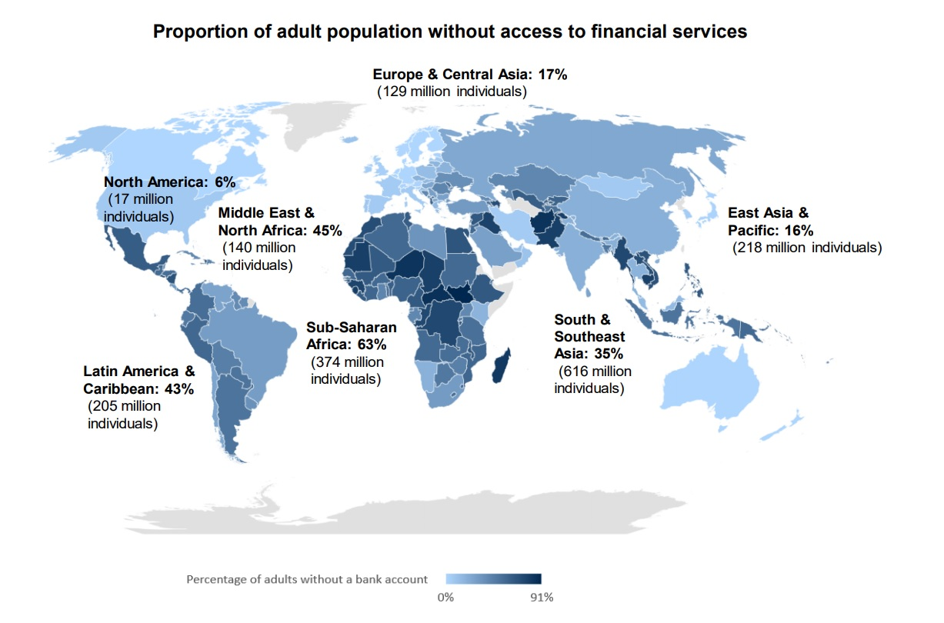
01
Adults without financial services

Slide 6
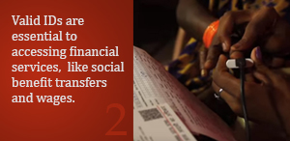
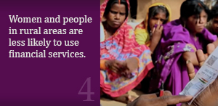
01
Hurdles to Accessing Financial Services
Financial literacy and capability
Valid identification documents
Consumer protection and regulation
Women and the rural poor
Usefulness

Slide 7
01
Benefits for over 1 Billion Muslims
More choice aligned with individuals lifestyle needs.
Hyper-personalized digital experiences
More competitive financial services costs
Increased convenience
Alternative access to financing
Increased financial knowledge and literacy
Access to financial services for the “unbanked”

Slide 8
01
Advantages of Islamic Fintech
Efficient Access
Attractive Cost & Fees
Flexibility & Transparency
Financial Inclusion & Literacy

Slide 9
Islamic banks help consumers adopt better financial habits by personalizing their digital experiences and giving users valuable insights into their finances.
Source: https://www.fintica.com/fintech-for-islamic-banking/

Slide 10
01
The threat to traditional Islamic Banks
Intensified competition
Reduced financing profit margins and service fees to remain competitive
Reduction in deposits and investments
Customer demands for digital channels (mobile, social, web)
Need for collaboration with fintech / technology providers.

Slide 11
02
Creating future proof digital Islamic innovation

Slide 12
02
Sharia-Compliant Digital Banking
Building digital-native sharia solutions
Empowering customers mobiles
Hyper personalised products & services
Growing sharia-compliant digital propositions

Slide 13
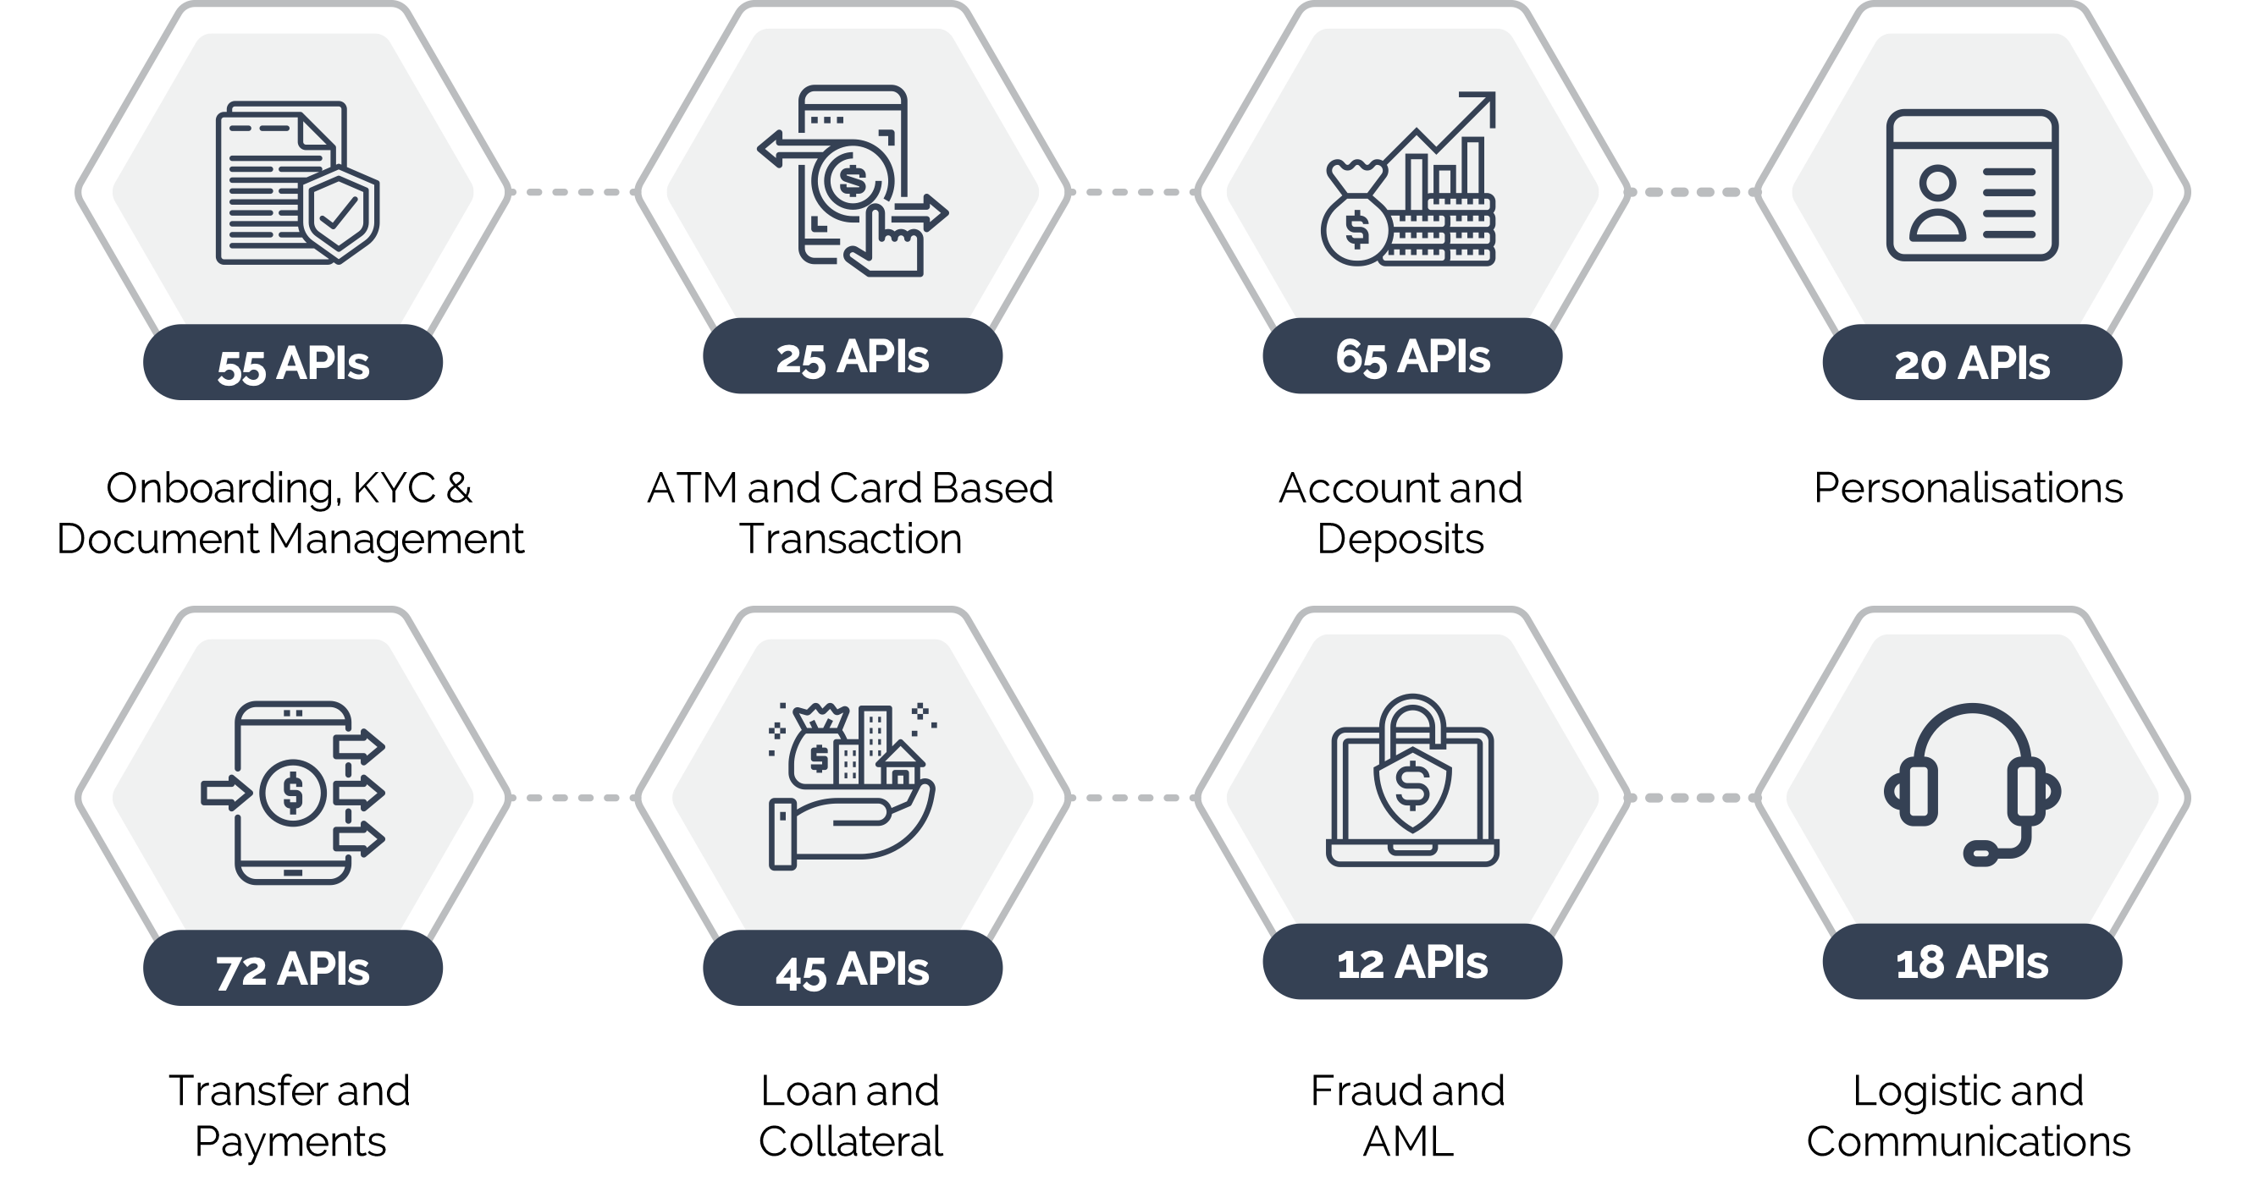
02
Digibanc™
The Digibanc™ “Digital Banking Suite” helps banks and financial institutions take bold steps to thrive in the future by enabling their value chain wins with the support of intuitive and flexible enterprise technologies that are ready for the future.
Digibanc™ is a complete “digital bank in a box” platform exclusively built on our proprietary technologies. The platform suite has been developed to enable enterprise wide digital transformation across organizations aiming to explore digital financial services
Highly Modular Construction
Scalable and Connectively Robust Framework
Digibanc™ 470+ Ready Integration APIs
Cloud Ready Open Technology Architecture
Superior Performance and Reliability
Embedded with Enterprise Grade Security
Adherence to International and Local Regulatory Compliances

Slide 14
02
New Paradigm for Digital Islamic Banking
Always Connected
Real Time & Personalized
Data First Approach
Contextual Engagements
Sharia Governance, Risk & Security
Mobile Online

Slide 15
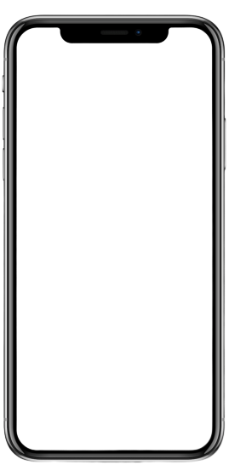
02
DIB - Pakistan
1st
Digital onboarding and capital investment product for an Islamic Digital bank.
80%
Average conversion rate within pilot stage.
60%
Reduction in acquisition and operating costs.
22days
MVP to launch with digital KYC and investment proposition

Slide 16
02
KFH - Jazeel
77%
Increase of customer engagement on Digibanc™ platform.
48%
Increase in cross-sell ratio of cards, investments and loans.
80%
Increase in frictionless customer conversion.
60%
Reduction in acquisition and onboarding costs.

Slide 17
Q&A

Slide 18
Omar Mansur
Global Enterprise Lead
omar@codebtech.com
Thank you
www.codebtech.com
codebase-technologies-cbt
Disclaimer
Restriction on Disclosure and Use of Data – This document contains confidential or proprietary information of Codebase Technologies and/or its affiliates and partners, therefore, the recipient shall not disclose, use, or duplicate this document, in whole or in part, for any purpose other than recipient's consideration of this information.
The Digibanc name, logo and “Demystifying Digital Financial Services” are trademarks of Codebase Technologies.
© 2021 Codebase Technologies - All Rights Reserved.

